Slide 1

Agenda
Set
Map
Comparator
Arrays
Collections

Slide 2
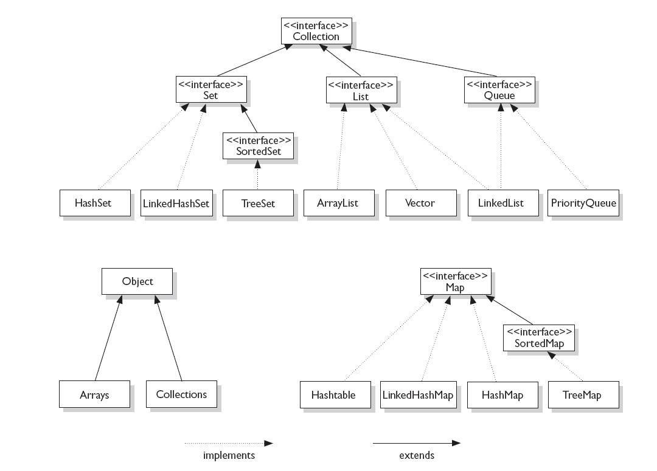

Slide 3
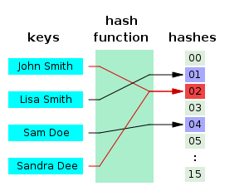
Hash function
A hash function is any algorithm or subroutine that maps large data sets of variable length to smaller data sets of a fixed length
Object.hashCode()

Slide 4
Set
A set is:
a collection of elements that does not allow duplicates
models the mathematical concept of abstract sets

Slide 5
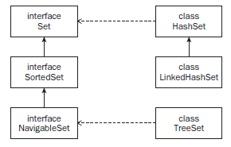
Sets
The Set interfaces and their implementing classes:

Slide 6
Set implementations
HashSet - a set that stores its elements in a hash table. There is no ordering to the items, and HashSet uses the hashCode method of its elements to determine their placing in the set.
LinkedHashSet - a set that stores its elements in a linked list hash table. The items are hashed based on their hashCode and also ordered in a doubly linked list.
TreeSet - a set that stores its elements in a tree data structure that is also sorted and navigable. The add, remove, and contains methods are guaranteed to work in log(n) time.

Slide 7
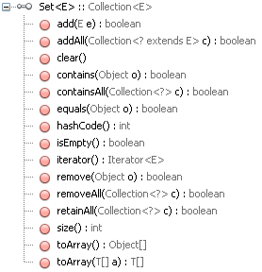
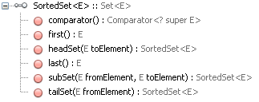
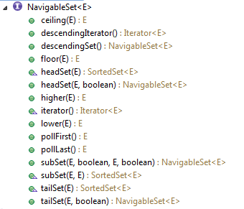

Slide 8
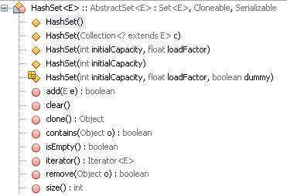
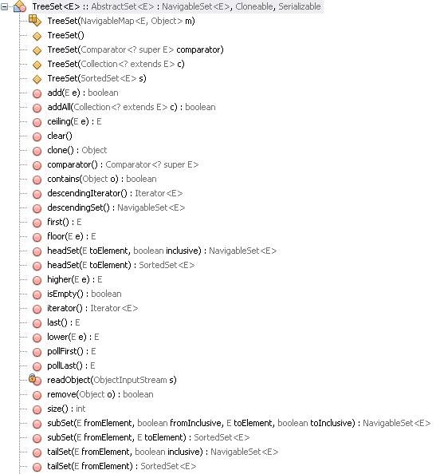
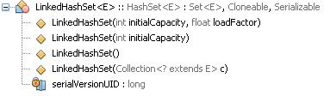

Slide 9
public static void main(String[] args){
Set<String> mySet1 = new HashSet<String>();
Set<String> mySet2 = new HashSet<String>();
// Set<String> mySet = new LinkedHashSet<String>();
// Set<String> mySet = new TreeSet<String>();
mySet1.add("C");
mySet1.add("A");
mySet1.add("D");
print(mySet1);
mySet2.add("A");
mySet2.add("E");
mySet2.add("B");
print(mySet2);
mySet1.retainAll(mySet2); // intersection
print(mySet1);
}
Output:
[D, A, C] [C, A, D]
[E, A, B] [A, E, B]
[A] [A]

Slide 10
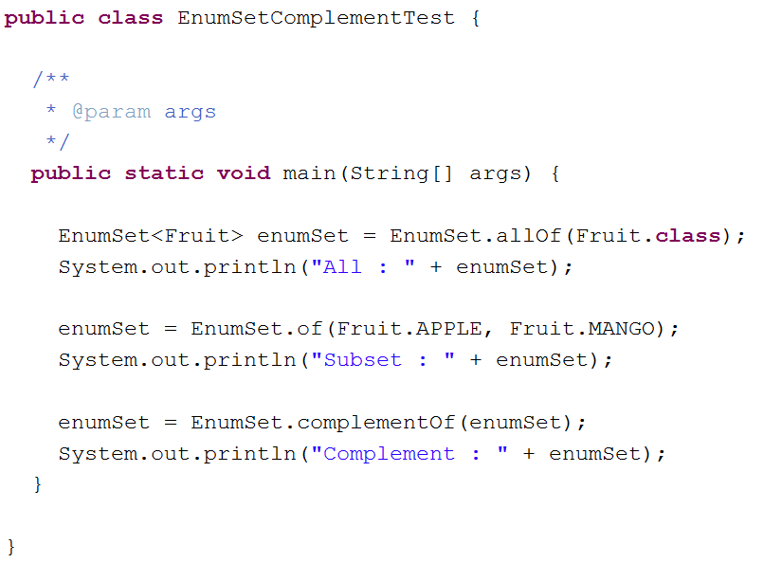
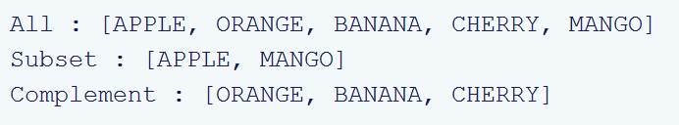

Slide 12
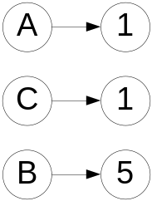
Map
A map is a collection that maps keys to values
No duplicated keys
Possible to operate on a Set of keys and a Collection of values
3 sets of operations: altering, querying and alternative views

Slide 13
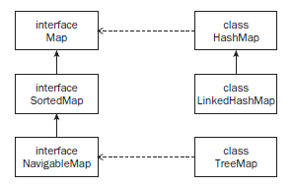
Maps
Map implementations:
HashMap – a map that stores its elements in a hash table. There is no ordering to the elements, and they are placed in the hash table based on their hashCode .
LinkedHashMap – a map that stores its element in a hash table and doubly linked lists. The linked list provides an ordering to the elements.
TreeMap – a map that stores its elements in a tree data structure with a natural or user - defi ned ordering. TreeMap provides log( n ) time for the methods that view or change elements in the tree.

Slide 14
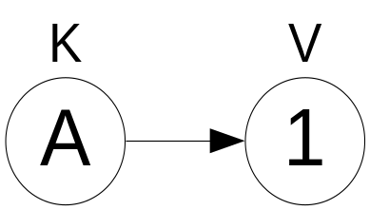
Entry
Key –value pair stored inside Map.
Interface Map.Entry
Methods:
  Object getKey();
  Object getValue();
  setValue(Object v);

Slide 15
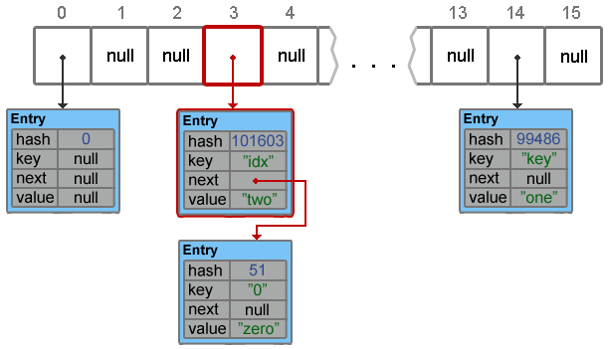
Hash Map
1. putForNullKey
2. hash(key.hashCode())
3. indexFor(hash, tableLength)
4. eq hash + eq key -> replace
5. add
threshold = capacity * loadFactor (def 0.75) - next size value at which to resize

Slide 16
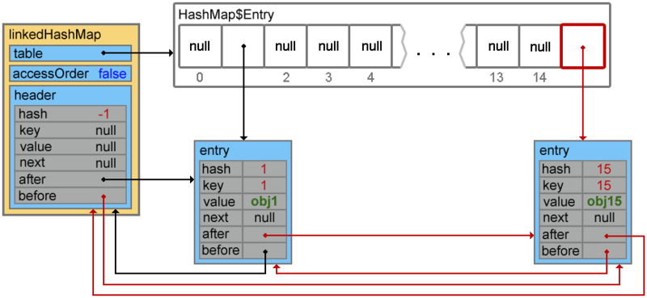
LinkedHashMap

Slide 17
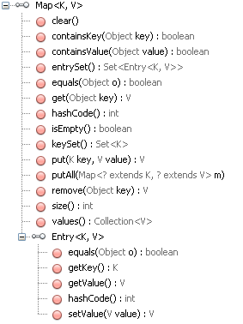

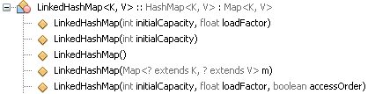

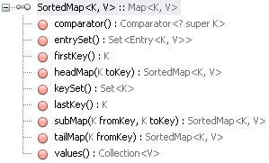

Slide 18
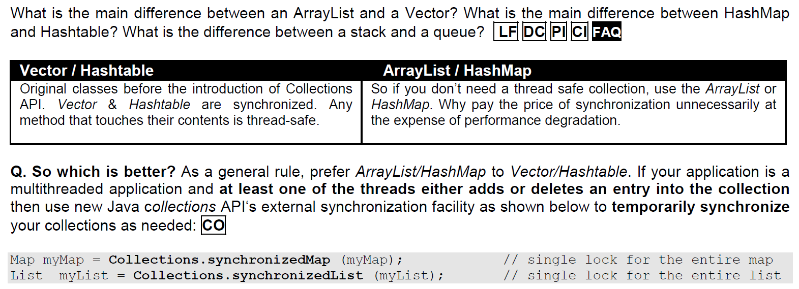

Slide 19
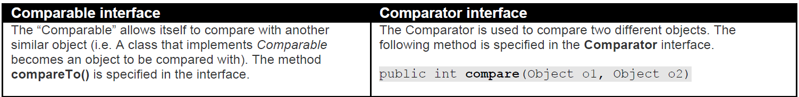


Comparison

Slide 20
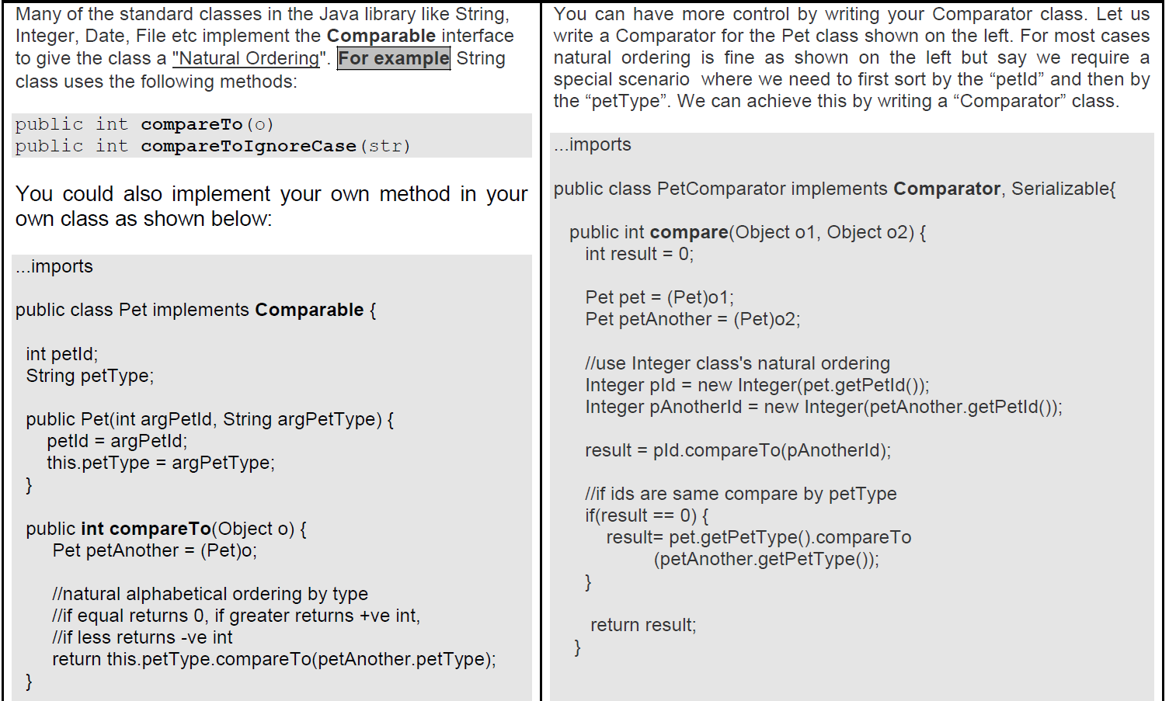

Slide 21
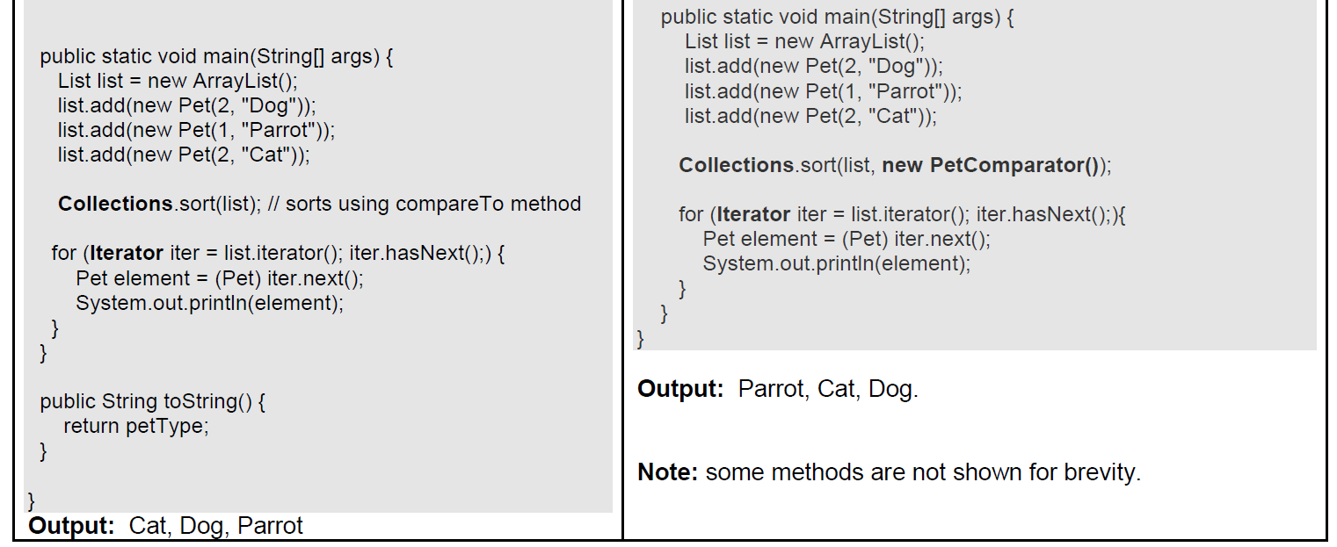

Slide 22
Utility classes

Slide 23
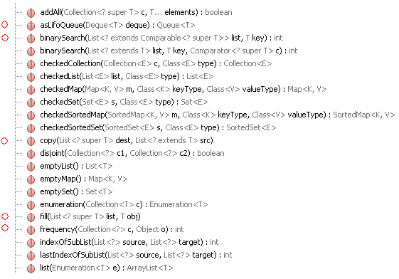
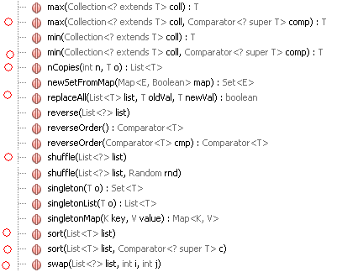
java.util.Collections

Slide 24
Synchronization Wrappers
public static <T> Collection<T> synchronizedCollection(Collection<T> c);
public static <T> Set<T> synchronizedSet(Set<T> s);
public static <T> List<T> synchronizedList(List<T> list);
public static <K,V> Map<K,V> synchronizedMap(Map<K,V> m);
public static <T> SortedSet<T> synchronizedSortedSet(SortedSet<T> s);
public static <K,V> SortedMap<K,V> ynchronizedSortedMap(SortedMap<K,V>m);

Slide 25
Unmodifiable Wrappers
public static <T> Collection<T> unmodifiableCollection(Collection<? extends T> c); public static <T> Set<T> unmodifiableSet(Set<? extends T> s);
public static <T> List<T> unmodifiableList(List<? extends T> list);
public static <K,V> Map<K, V> unmodifiableMap(Map<? extends K, ? extends V>m);
public static <T> SortedSet<T> unmodifiableSortedSet(SortedSet<? extends T> s);
public static <K,V> SortedMap<K, V> unmodifiableSortedMap(SortedMap<K, ? extends V> m);

Slide 26
Checked Wrappers
static <E> Collection checkedCollection(Collection<E> c, Class<E> elementType)
static <E> List checkedList(List<E> c, Class<E> elementType)
static <E> Set checkedSet(Set<E> c, Class<E> elementType)
static <E> SortedSet checkedSortedSet(SortedSet<E> c, Class<E> elementType)
static <K, V> Map checkedMap(Map<K, V> c, Class<K> keyType, Class<V> valueType)
static <K, V> SortedMap checkedSortedMap(SortedMap<K, V> c, Class<K> keyType, Class<V> valueType)
Any attempt to insert an element of the wrong type will result in an immediate ClassCastException.

Slide 27


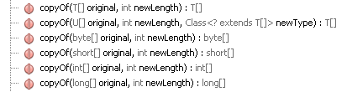


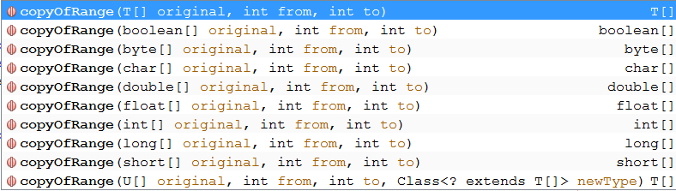

java.util.Arrays
This class contains various methods for manipulating arrays (such as sorting and searching).
This class also contains a static factory that allows arrays to be viewed as lists.
The methods in this class all throw a NullPointerException if the specified array reference is null, except where noted.

